Slide 1
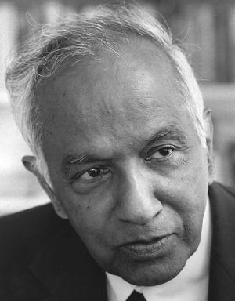
Famous
Astronomers
Subrahmanyan Chandrasekhar White Dwarf Stars

Slide 2
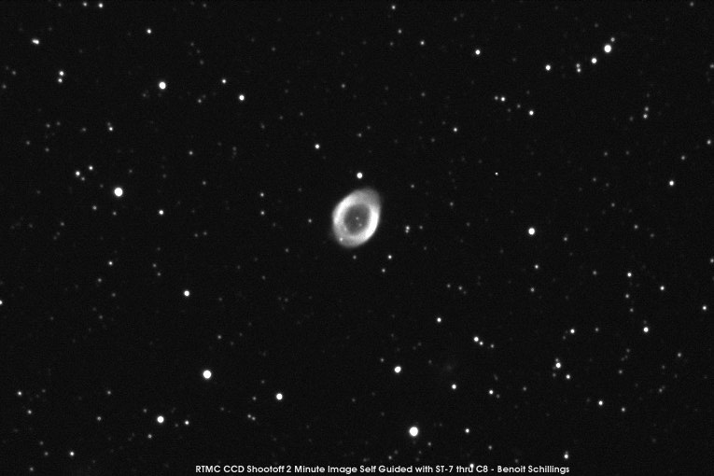
M57 Through the Telescope
M57 is called the "Ring Nebula."
It is a planetary nebula.

Slide 3
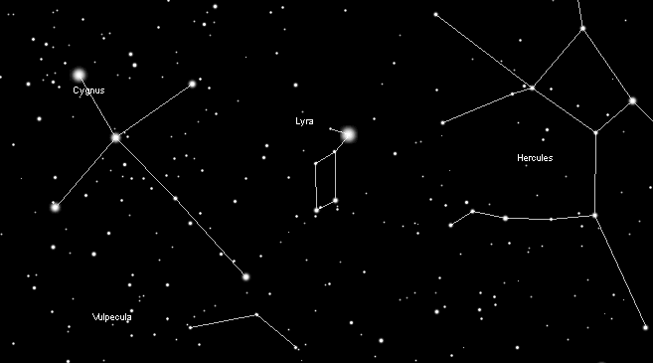
M57 in the Night Sky
Cygnus
Lyra
Hercules
M 57
Vulpecula
M57 is at the base of the constellation Lyra the Harp

Slide 4
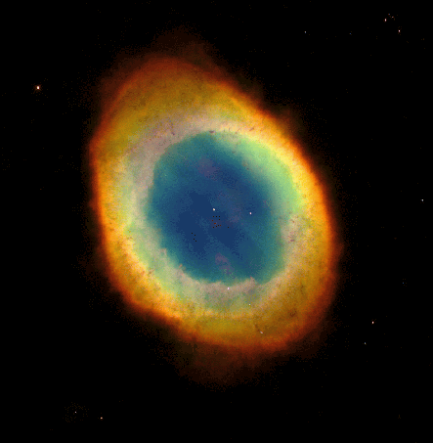
Hubble Space Telescope Image of M57
M57 (Ring Nebula) is about a light-year in diameter and 2,000 light years away from us.
The Ring Nebula is a planetary nebula: a vast bubble of gas that was ejected from a dying star.
(The colors are approximately true colors.)

Slide 5
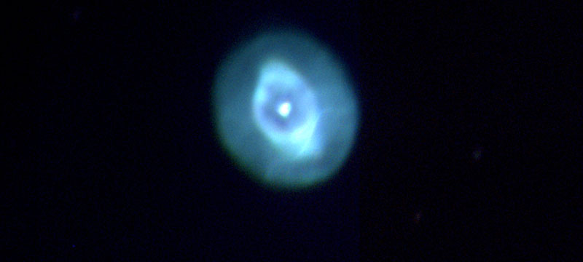
What is a Planetary Nebula?
A planetary nebula occurs when a star similar in size to our Sun runs out of fuel and dies.
Despite the name, it has NOTHING to do with planets!

Slide 6
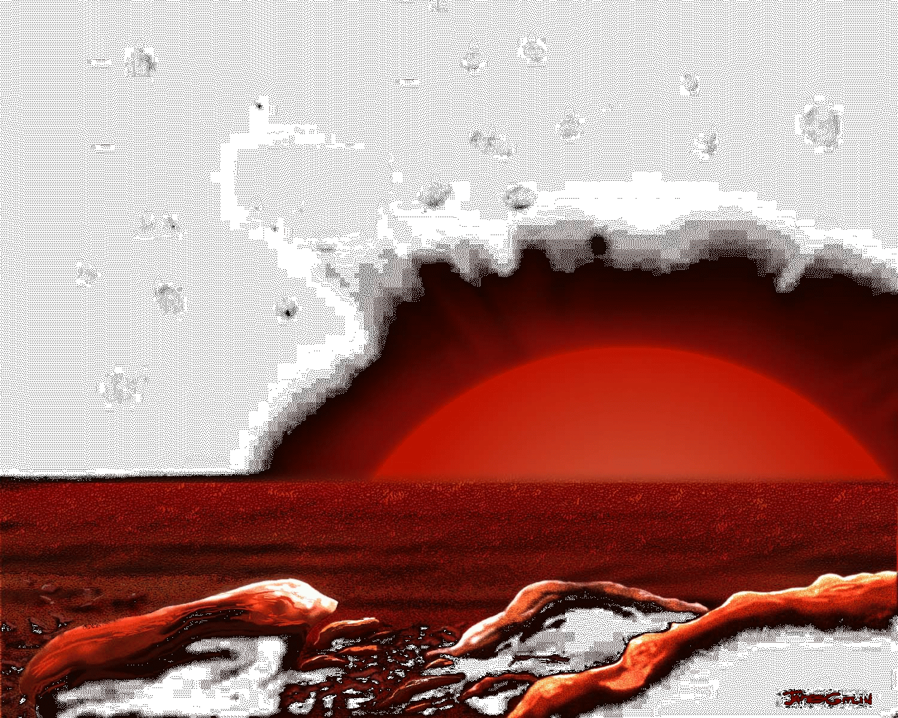
What is a Planetary Nebula?
As the star’s fuel begins to run out, it cools and expands, becoming a Red Giant star.

Slide 7
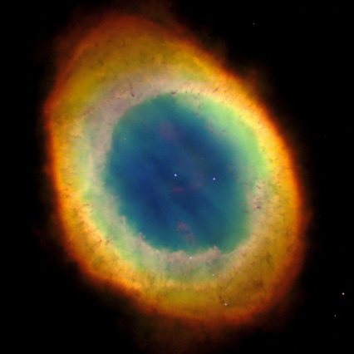
What is a Planetary Nebula?
Finally, when its fuel is exhausted, the star “puffs” off its outer layers in shells around the still-hot core.
These puffed off gas shells are what we see as the planetary nebula.

Slide 8
What is a Planetary Nebula?
As the outer layers of the star expand, the rest of the star collapses into a tiny, Earth-sized object called a "White Dwarf"

Slide 9
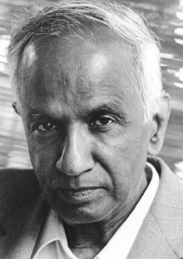

The Chandrasekhar Limit
Subrahmanyan Chandrasekhar found that the maximum mass of a white dwarf is 1.4 solar masses. This value is now referred to as the Chandrasekhar
Limit

Slide 10
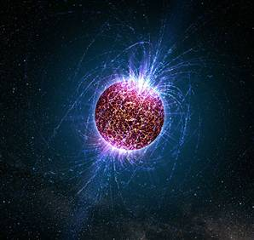
The Chandrasekhar Limit
Neutron star
Black Hole
Stellar remnants with masses greater than 1.4 times the mass of our Sun will collapse into an object of enormous density such as a neutron star or black hole.

Slide 11
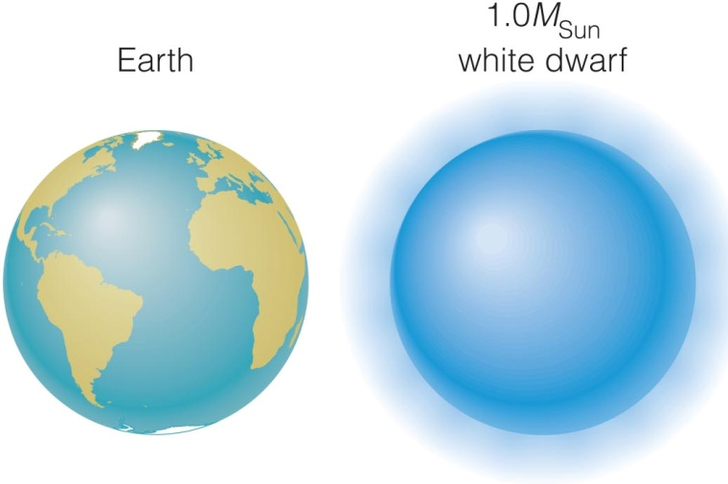
White Dwarf Facts
A white dwarf is only the size of Earth however it has the mass of our Sun!

Slide 12
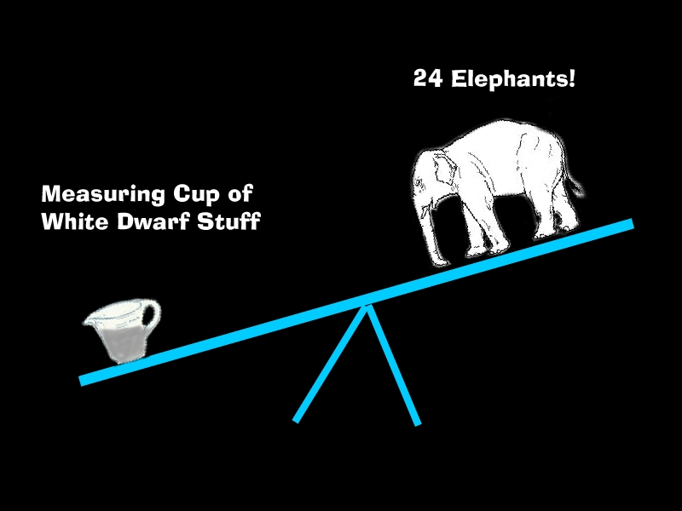
White Dwarf Facts
In fact, a cup of white dwarf material brought back to Earth would weigh as much as 24 elephants!

Slide 13
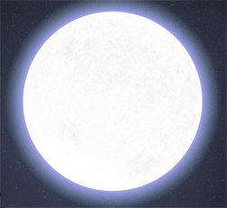
White Dwarf Facts
1.4 solar mass
1.3 solar mass
1.2 solar mass
1.1 solar mass
As the masses of white dwarfs INCREASE, their radii DECREASE because of the strength of gravity.

